Slide 1
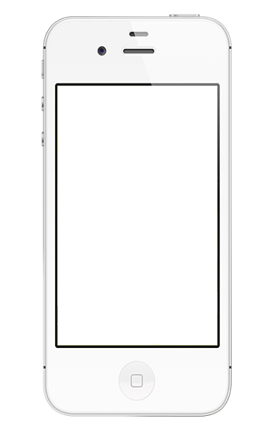
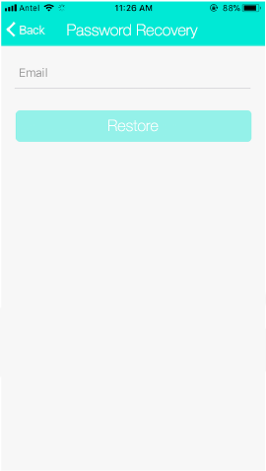
Format of the APP
Font to use Helvetica Neue (Thin) for body, Helvetica Neue (Light) for Header, font size use the same as existing app template
Color use #4ac4fa (this is a like a light blue color) instead of #00e9d5 (existing green color from the template)
#4ac4fa
#00e9d5

Slide 2
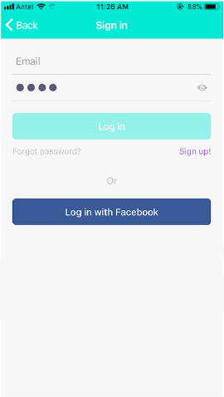
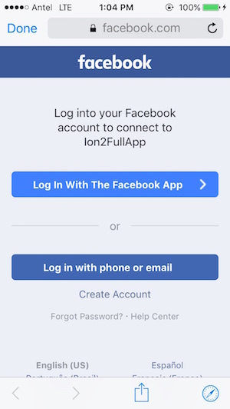
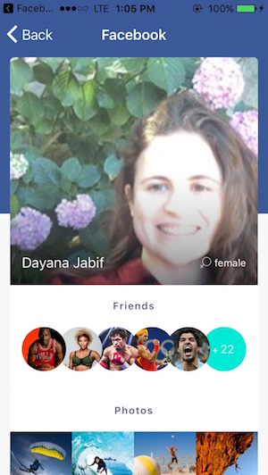
Login Page
From the existing template, delete off login with twitter and google
3 Buttons here:
Forgot Password? → slide 3
Sign up! → slide 4
Login with Facebook - Same as existing template on Facebook native login integration vas below:
After successful login, it will go to the Listing Page, just like the existing template → slide 5

Slide 3
Forget Password Page
Same as the webpage (http://whospets.com/en/registration/registration/registration), then on just follow the existing flow.

Slide 4
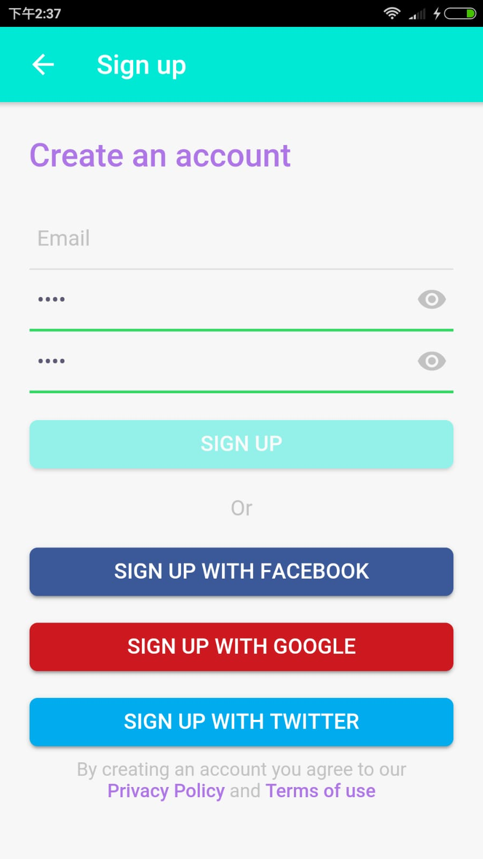
Register with email Page
Same as the webpage (http://whospets.com/zh/registration/registration/recovery), ask for username, password and Email, then on just follow the existing flow.
Please note, there is an existing register page available on App template but without the username. Just take out “sign up with google” and “ sign up with Twitter” and add “Username” on top of Email then we are cool to go!
This is from the existing template →

Slide 5
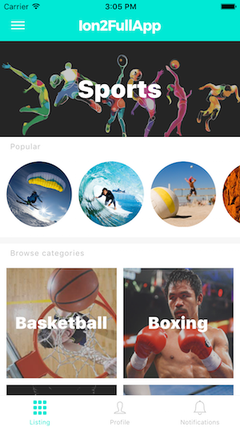
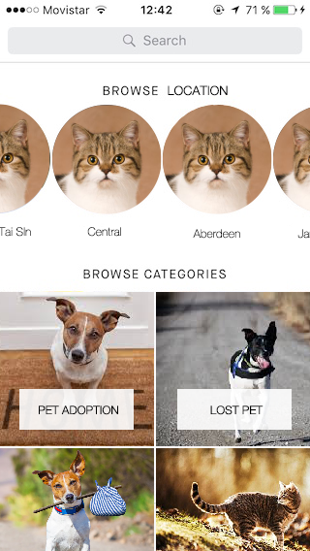
Listing Page
Amend from this Page on the left, just changing the layout a bit to what it looks like on the right. →
Each Hong Kong District have their own feed to show all posts (from below). This will be the first page to go to after login depending on the user set location (district). E.g. Person live in “Central” will go directly to the “Central” feed right after login.
Browse Categories have the following:
Adoption - pet
Lifestyle - post
Lost Pet - pet
Pet Found - pet
Secondhand - sell
Q&A - post
The bottom of this template page has a menu bar, we will be keeping it which include 3 items:
Listing – which is this page
Profile – This is going to the user profile page
Notification – Keep it to the same format to the existing template
Search bar at the top allows people to search for the pet, this function is also on the webpage version.

Slide 6
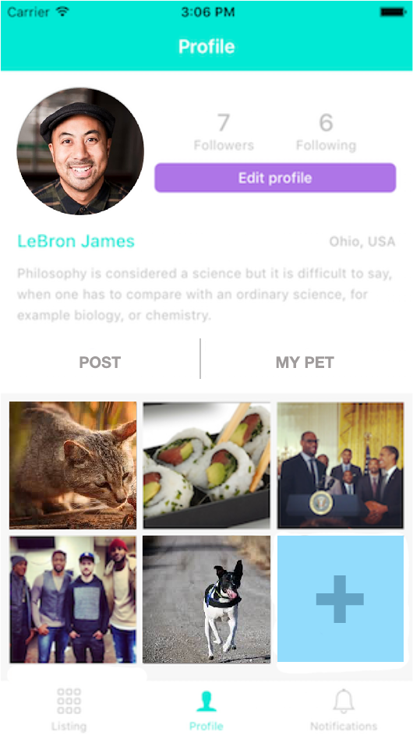
User Profile Page
On the top, user can see followers and who they are following just the same as the template.
Edit Profile button → go to slide 7
Underneath the picture, it shows the Name, with District and Country written on the right.
There should be a paragraph to describe what kind pet person he/she is.
Bottom half have 2 tab, “POST” – which is all the post that the user is posting. “MY Pet” which is the pet profile he/she has under their user account. The blue add button allow the user to add post or pet from the “form”.
Change the “Edit Profile” button color to #018bc8 please
Form → slide 8
When first login, go to Edit Profile first.
#018bc8

Slide 7
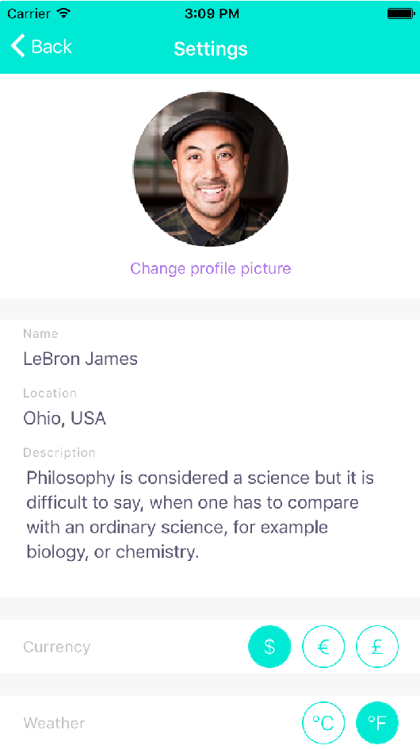
Setting Page
Amend from the existing template, change “Description” to “Your Philosophy of Pet care”
Add “Gender”. Use Currency type, can choose from F, M, NA
Replace Location, Add “Country” and “District”, both can be selected from list, just like the “Select your language” tab from the template.
2 Languages, English and Chinese
Notification Setting → slide 14
This is from the existing template →

Slide 8
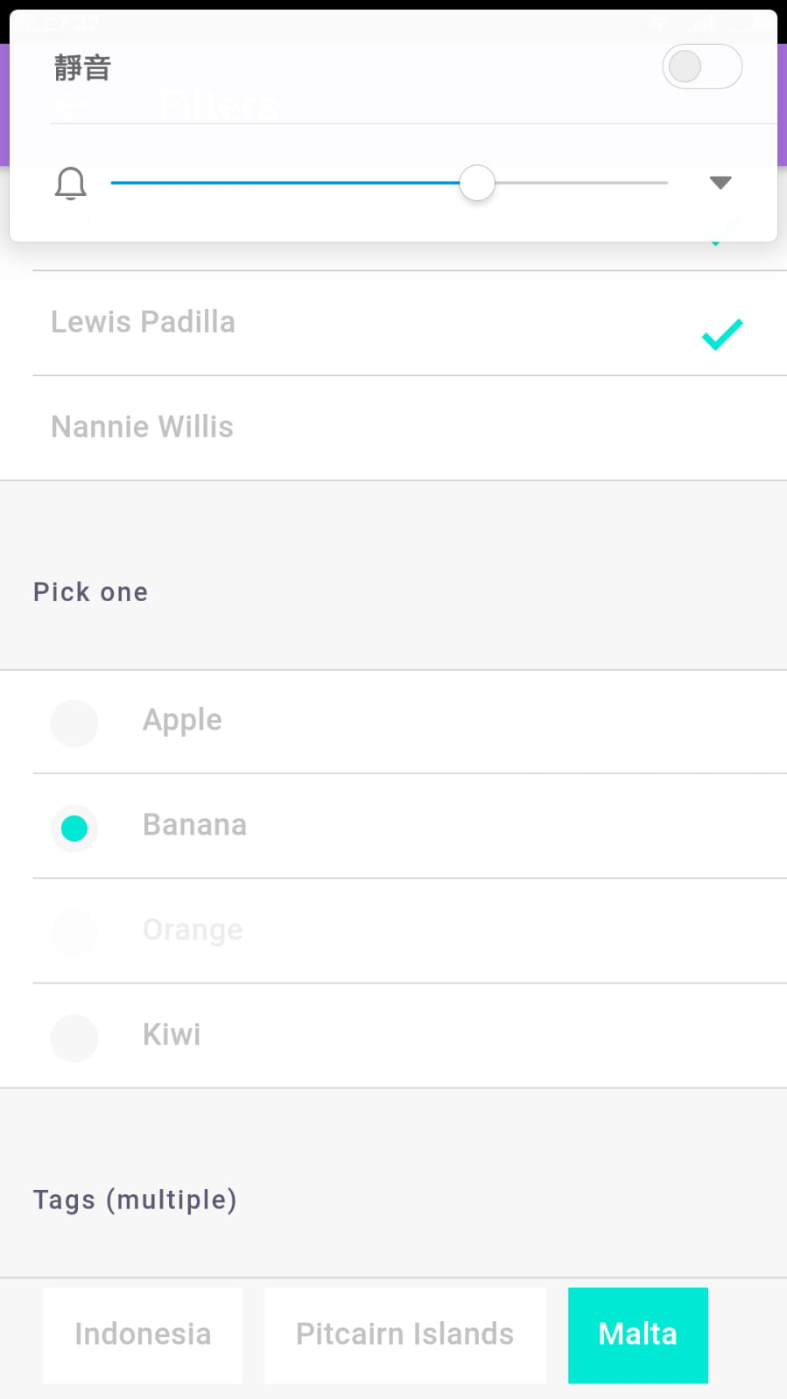
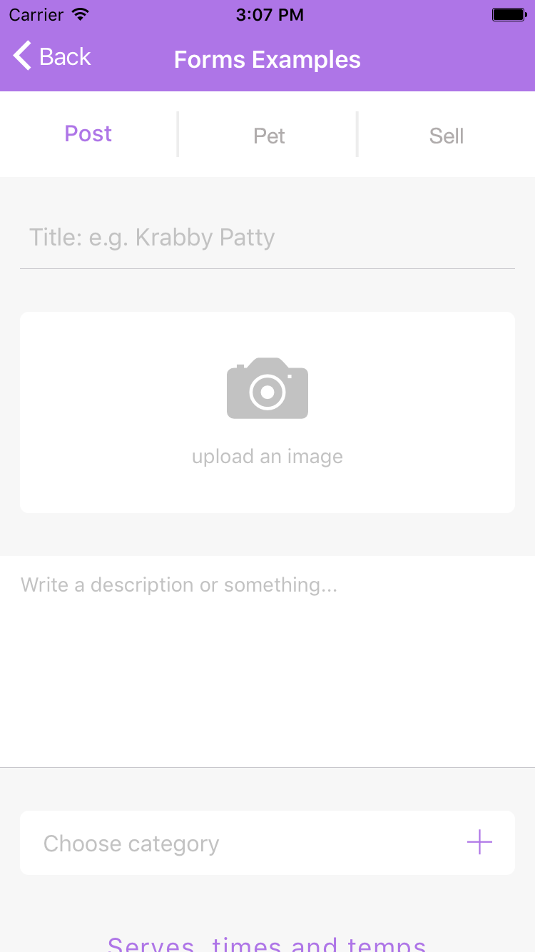
Add Post Page
Post – Lifestyle or Q&A →
User can identify this post is under lifestyle or Q&A? This goes right underneth Post/ Pet/ Sell. This is available from template.
“Choose category” change to “Choose Pet”, therefore this post will include all the parameters from the pet. E.g. pet type, location and etc…
Only allow to choose 1 pet, not more than 1.
Use the existing “Submit” button from the template.
After Submit, the Post layout → slide 11

Slide 9
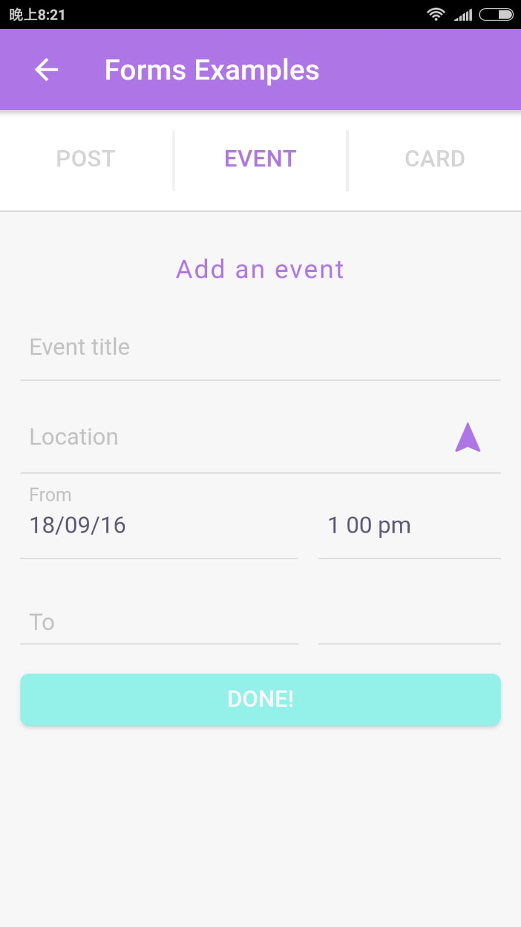
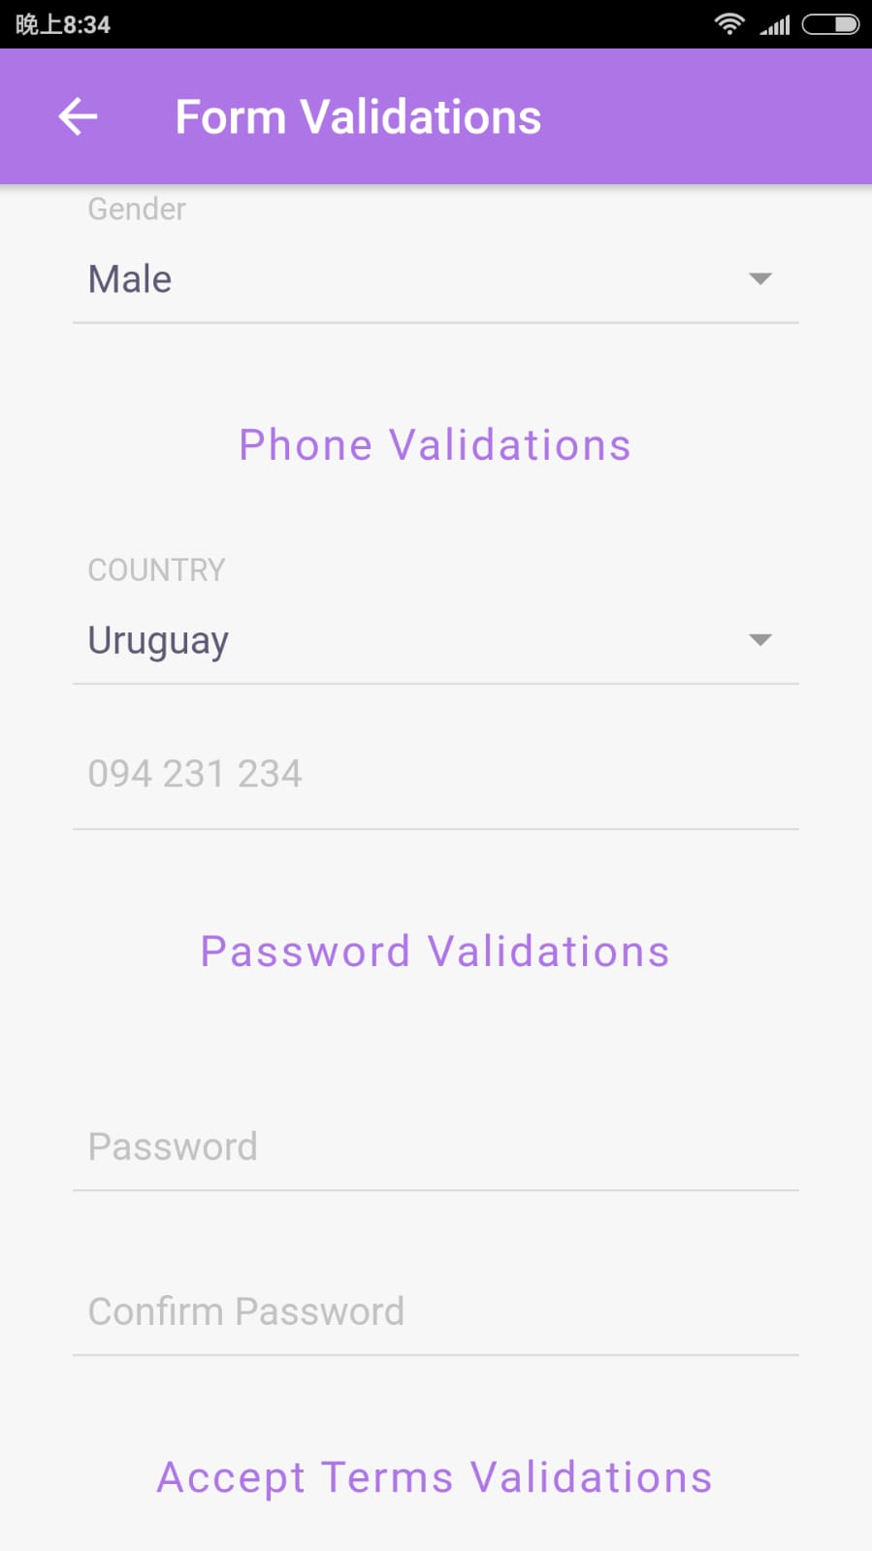
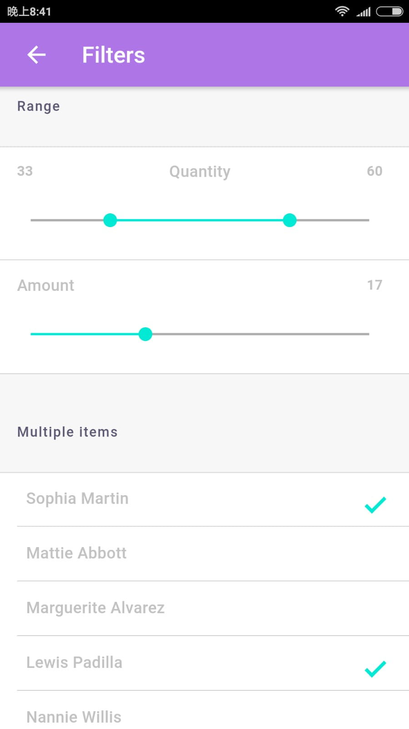
Add Pet Page
Add Pet – User can add Pet profile onto their profile
Same info with the website: http://whospets.com/en/shop/products/create, include the following:
Pet’s Name* – Style 1
Upload an image – style 8
Date Born – style 3
Type of Pet – style 4
Pet Breed – style 5 (slider), if not go for style 6.
Pet Profile – style 7
Pet ID – Style 1
Gender – Style 4
Pet Color – Style 6
Pet Size – Style 4
Pet Weight – Style 9 (max. 80kg)
Pet Height – Style 9 (max. 100 cm)
Country - style 5 (slider), if not go for style 6.
District - style 5 (slider), if not go for style 6.
Mobile Phone – Style 1
Pet Status – Style 2
Date Lost – Style 3 (Only show if “Pet Lost” status)
Date Found – Style 3 (Only show if “Pet Found”)
Reward – Style 9 (Only show if “Pet Lost” status), max HKD 100,000
20) Last seen appearance – Style7 (Only show if “Pet Lost” status)
Style 2
Style 1
Style 8
Style 3
Style 4
Style 7
Style 5
Style 6
Style 9

Slide 10
Sell Page
Sell – To list Second hand stuff for sale if anyone is interested.
Title – style 1
Upload image – style 8
Some description –style 7
Price – Style 9
Country - style 5 (slider), if not go for style 6.
District - style 5 (slider), if not go for style 6.
Color – Style 6
Weight – Style 9 (max. 100kg)
Size – Style 1
Style 1
Style 8
Style 7
Style 5
Style 6
Style 9

Slide 11
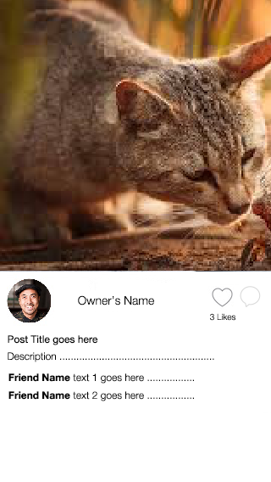
Post Feed Page
When click on the post, this appears like this. Lifestyle or Q&A will both be in this format.
When clicked on individual post, it show like this for individual post, for Feed, it will just show like this and scroll all the way down to all post.

Slide 12
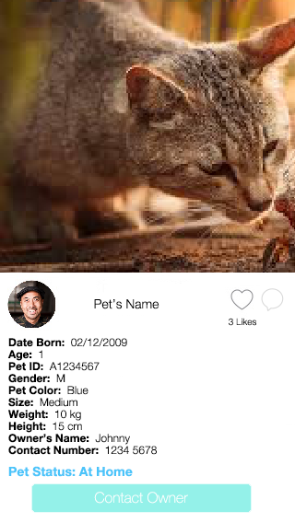
Individual Pet Page
This is what the Pet Profile page looks like, for lost pet or found pet, there are more info, include the following:
Date Lost
Date Found
Reward
Last seen appearance
It will go in between the info and Pet Status area.
When anyone leave comments, it will go under Pet Status, just like how Post Feed page works.

Slide 13
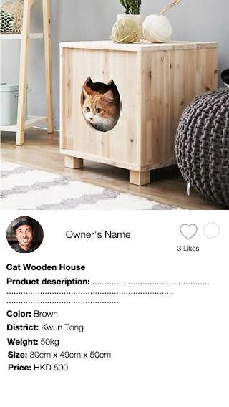
Sell Product Page
When click on the post, this appears like this. Lifestyle or Q&A will both be in this format.
When clicked on individual post, it show like this for individual post, for Feed, it will just show like this and scroll all the way down to all post.

Slide 14
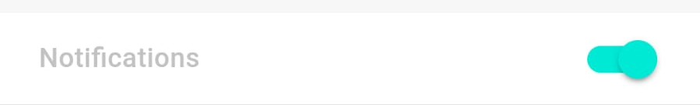
Notification Setting
Each of the notification below, user have the ability to turn it off or on. Default is all on.
Receiving notification when someone has lost their pet in your District.
Receiving notification when a new pet is looking for adoption.
Receiving notification when someone comment on your post.
Receiving notification when someone has something to sell for your pet located in your area.
Receiving notification when a lost pet is found and we are still in the search of their owner in your district.

Slide 15
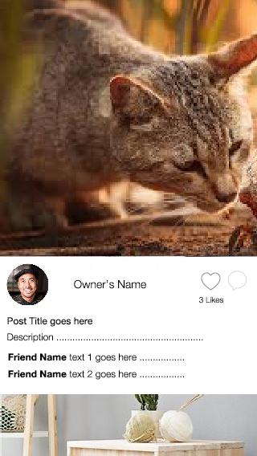
Feed Sequence
For all Feed Post, these are the Priority to show on top
Same type of pet on top
Most update post
In the same area

Slide 16
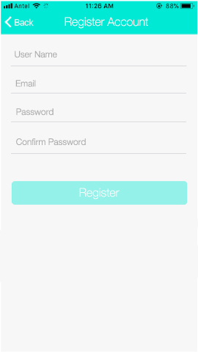

Flow Map
5. Setting Page
3. Register Account
2. Password Recovery
1. Login Page
4. Feed Page

Slide 17
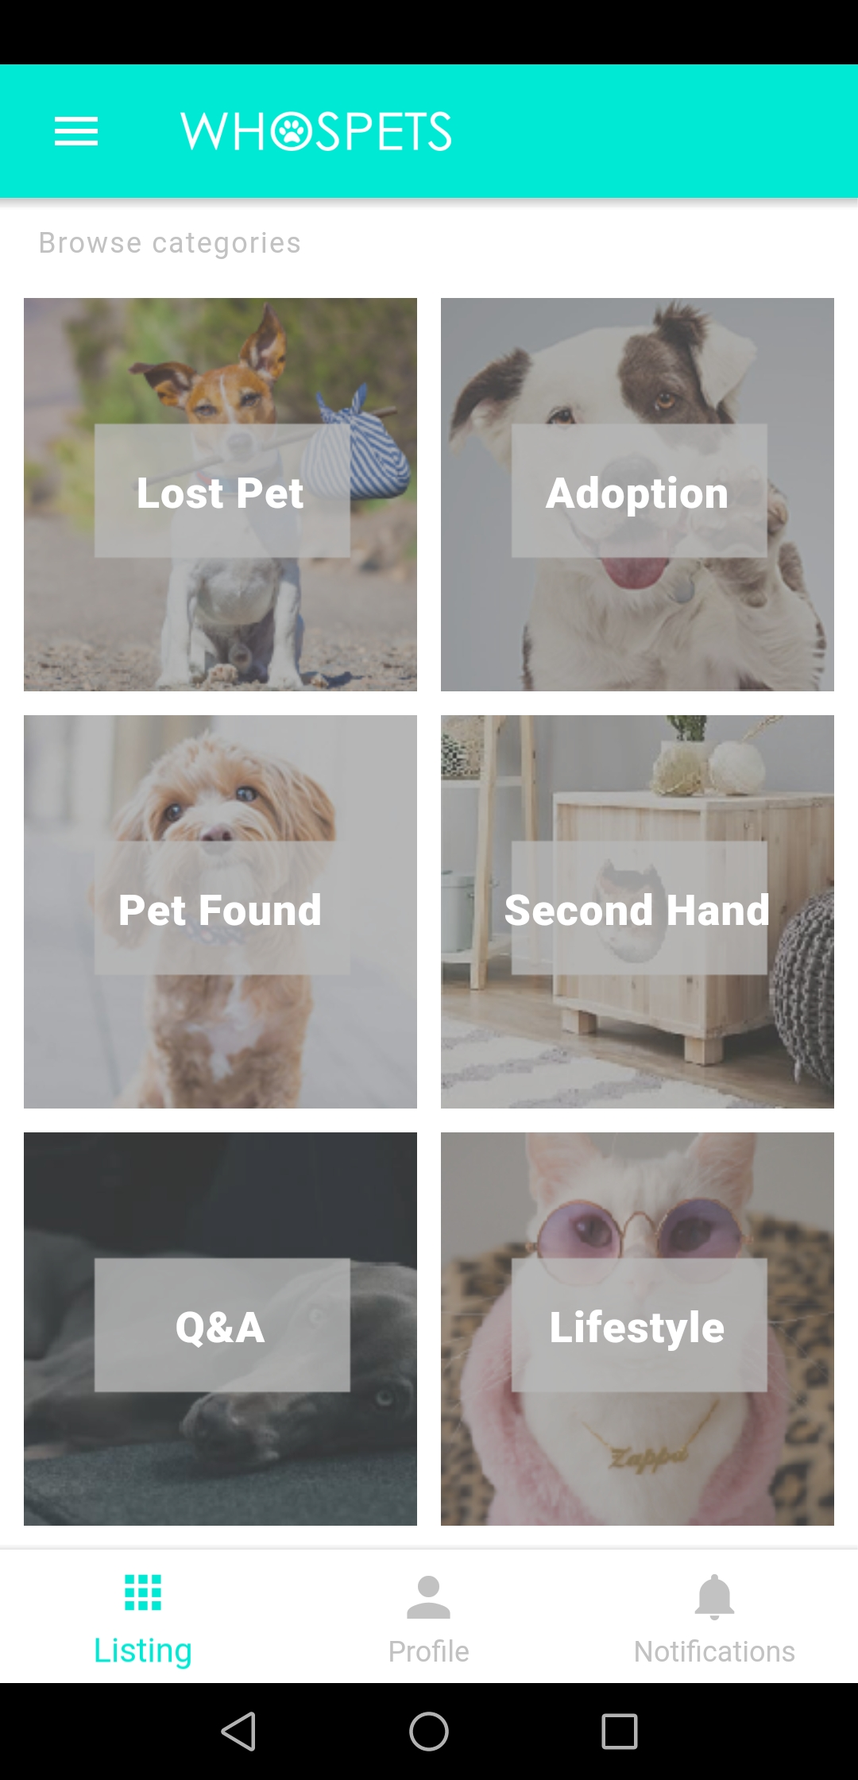
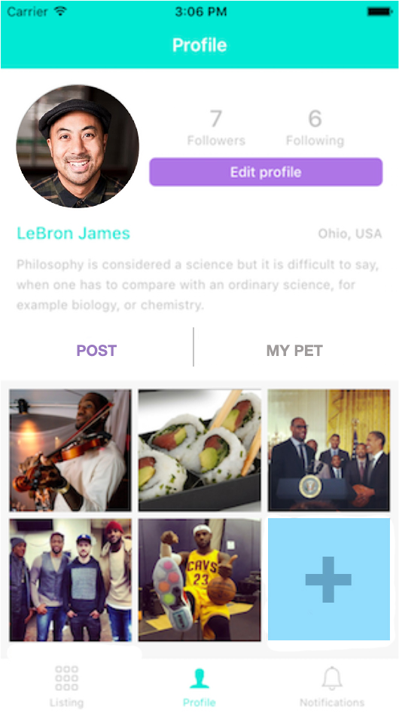
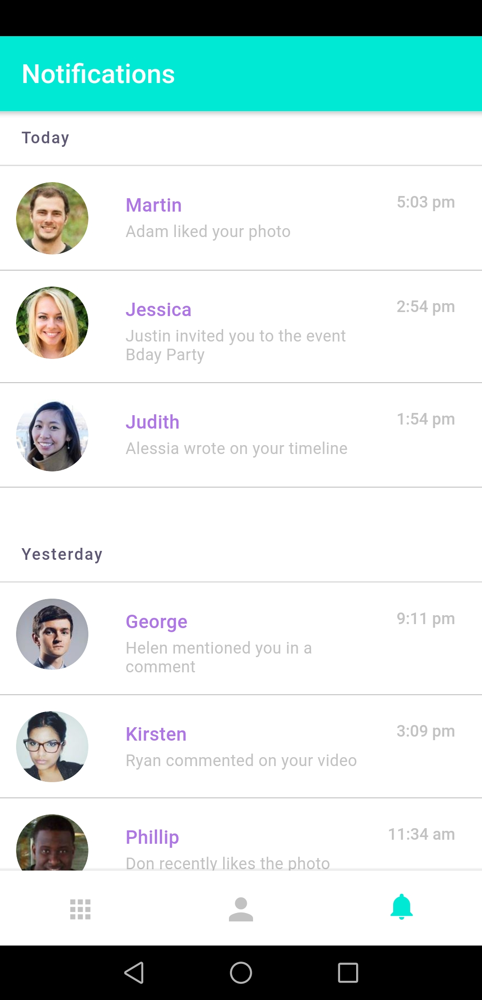

Flow Map
6. Listing Page
8. Profile Page
4. Feed Page
7. Notification Page

Slide 18
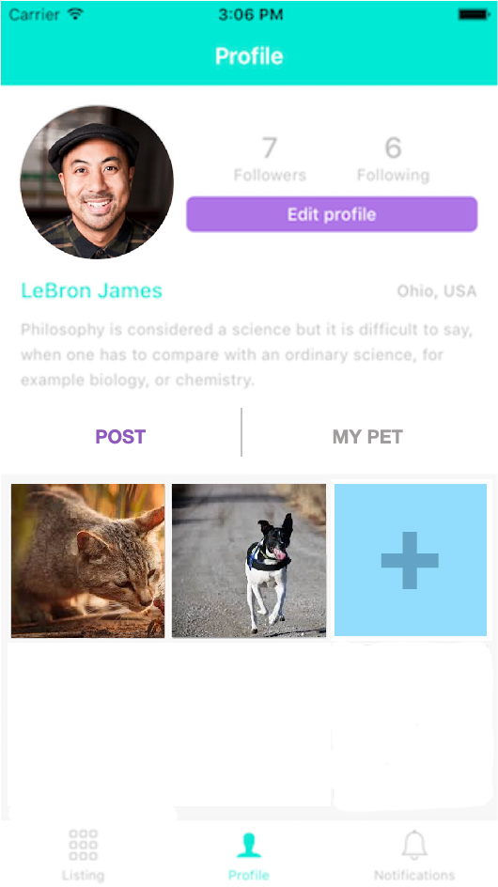
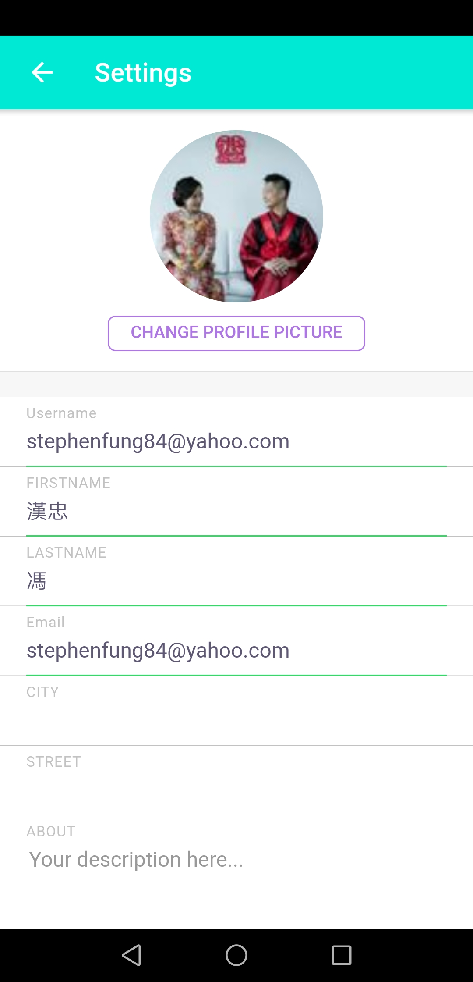
Flow Map
13 or 14. Post or Sell Page
9. Pet Profile Page
8. Profile Page
8. Profile Page
5. Setting Page

Slide 19


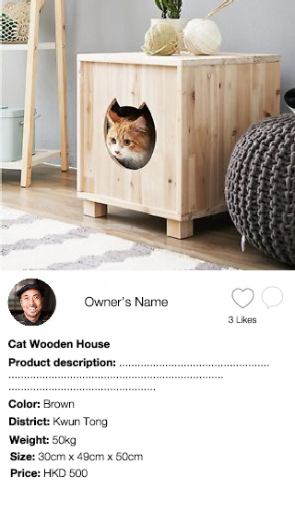
Flow Map
9. Pet Info Page (same layout for lost pet, adoption, pet found and normal pet profile)
6. Listing Page
10. Post Page (Same layout for Q&A and Lifestyle)
11. Sell Page

Slide 20
Flow Map
Go to Slide 10
Go to Slide 8
Go to Slide 9
EDIT
EDIT
EDIT
13. Post Page (User view of it’s own Q&A and lifestyle post)
14. Sell Page
(User view of it’s own sell post)
12. Pet Info Page (User view of it’s own pet)

